Slide 1
Lab 5 – Review: K-Means(++), Hierarchical Clustering, DBScan, Soft Clustering
CS 506

Slide 2
Density Based Clustering (DBScan)

Slide 3
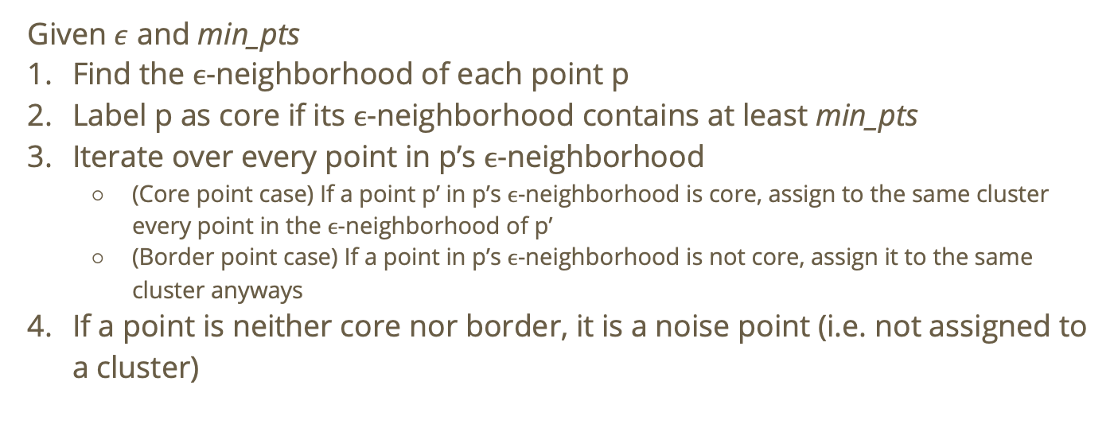
Recall: Density Based Clustering
Given $ε$ and min_pts
Find the $ϵ$-neighborhood of each point p
Label p as core if its $ϵ$-neighborhood contains at least min_pts
Iterate over every point in p’s $ϵ$-neighborhood
(Core point case) If a point p’ in p’s $ϵ$-neighborhood is core, assign to the same cluster every point in the $ϵ$-neighborhood of p’
(Border point case) If a point in p’s $ϵ$-neighborhood is not core, assign it to the same cluster anyways
If a point is neither core nor border, it is a noise point (i.e. not assigned to a cluster)

Slide 4
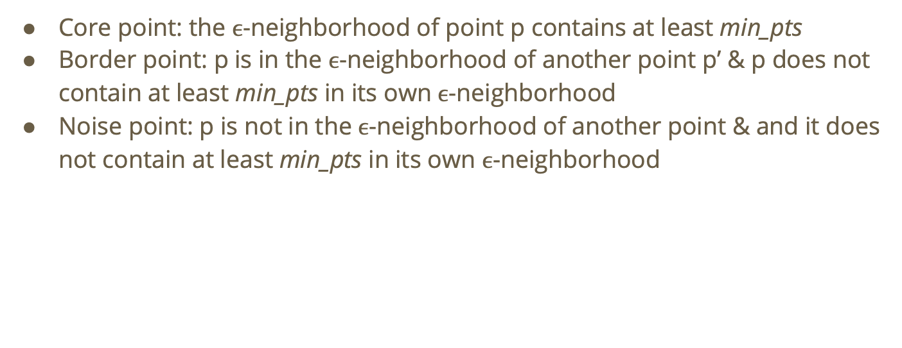
Recall: Categories of points
Core point: the $ϵ$-neighborhood of point p contains at least min_pts
Border point: p is in the $ϵ$-neighborhood of another point p’ & p does not contain at least min_pts in its own $ϵ$-neighborhood
Noise point: p is not in the $ϵ$-neighborhood of another point & and it does not contain at least min_pts in its own $ϵ$-neighborhood

Slide 5
DBScan visualized
Min_pts = 3
𝝴
Core point ✔

Slide 6
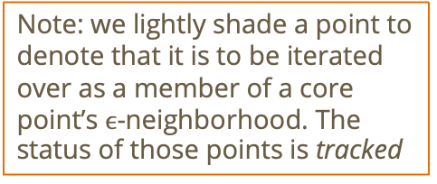
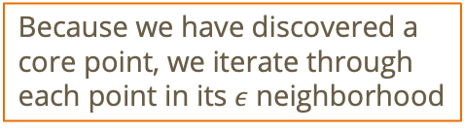
DBScan visualized
Because we have discovered a core point, we iterate through each point in its $ε$ neighborhood
Min_pts = 3
𝝴
Note: we lightly shade a point to denote that it is to be iterated over as a member of a core point’s $ϵ$-neighborhood. The status of those points is tracked

Slide 7
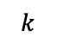
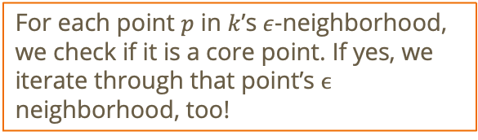
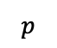
DBScan visualized
$$p$$
For each point $p$ in $k$’s $ε$-neighborhood, we check if it is a core point. If yes, we iterate through that point’s $ϵ$ neighborhood, too!
Min_pts = 3
$$k$$

Slide 8
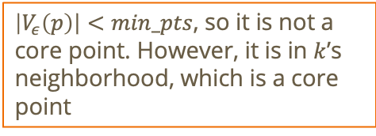
DBScan visualized
$$p$$
$\left|V_{ε}\left(p\right)\right|<min_pts$, so it is not a core point. However, it is in $k$’s neighborhood, which is a core point
Min_pts = 3
$$k$$

Slide 9
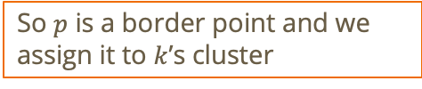
DBScan visualized
So $p$ is a border point and we assign it to $k$’s cluster
Min_pts = 3
$$p$$
$$k$$

Slide 10
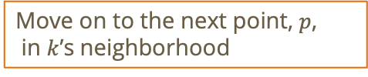
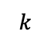
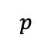
DBScan visualized
Min_pts = 3
Move on to the next point, $p$,
in $k$’s neighborhood
$$p$$
$$k$$

Slide 11



Do not edit How to change the design
How will point p be assigned? (Note: we are assuming that for a point to be considered a part of p’s epsilon neighborhood, it must be entirely in the circle representing p’s neighborhood)
The Slido app must be installed on every computer you’re presenting from

Slide 12
DBScan visualized
Min_pts = 3
$$p$$
$$k$$

Slide 13
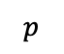
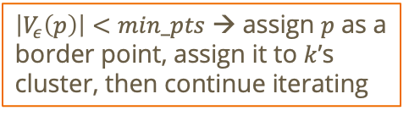
DBScan visualized
Min_pts = 3
$$k$$
$$p$$
$\left|V_{ε}\left(p\right)\right|<min_pts$ → assign $p$ as a border point, assign it to $k$’s cluster, then continue iterating

Slide 14
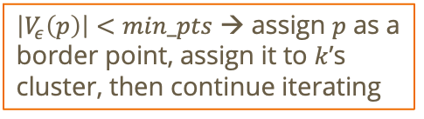
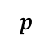
DBScan visualized
Min_pts = 3
$$k$$
$$p$$
$\left|V_{ε}\left(p\right)\right|<min_pts$ → assign $p$ as a border point, assign it to $k$’s cluster, then continue iterating

Slide 15
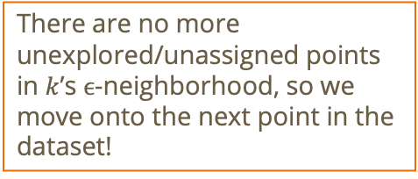
DBScan visualized
Min_pts = 3
There are no more unexplored/unassigned points in $k$’s $ϵ$-neighborhood, so we move onto the next point in the dataset!
$$k$$

Slide 16
DBScan visualized
Min_pts = 3

Slide 17
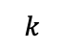
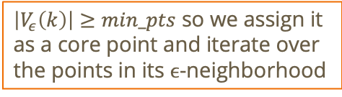
DBScan visualized
Min_pts = 3
$\left|V_{ε}\left(k\right)\right|≥min_pts$ so we assign it as a core point and iterate over the points in its $ϵ$-neighborhood
$$k$$

Slide 18
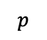
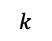
DBScan visualized
Min_pts = 3
$$p$$
$$k$$

Slide 19
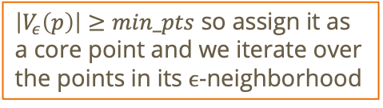
DBScan visualized
Min_pts = 3
$\left|V_{ε}\left(p\right)\right|≥min_pts$ so assign it as a core point and we iterate over the points in its $ϵ$-neighborhood
$$p$$

Slide 20
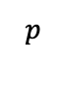
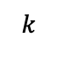
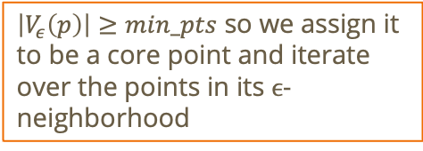
DBScan visualized
Min_pts = 3
$\left|V_{ε}\left(p\right)\right|≥min_pts$ so we assign it to be a core point and iterate over the points in its $ϵ$-neighborhood
$$k$$
$$p$$

Slide 21
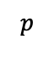
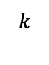
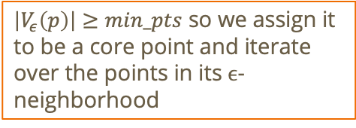
DBScan visualized
Min_pts = 3
$\left|V_{ε}\left(p\right)\right|≥min_pts$ so we assign it to be a core point and iterate over the points in its $ϵ$-neighborhood
$$k$$
$$p$$

Slide 22
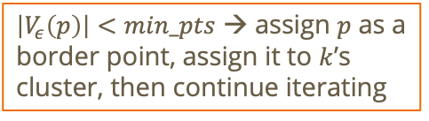
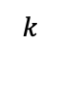
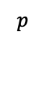
DBScan visualized
Min_pts = 3
$$p$$
$\left|V_{ε}\left(p\right)\right|<min_pts$ → assign $p$ as a border point, assign it to $k$’s cluster, then continue iterating
$$k$$

Slide 23
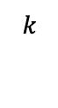
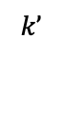
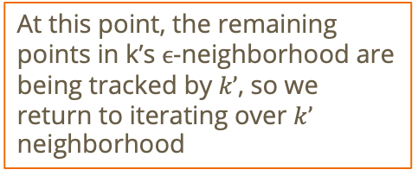
DBScan visualized
Min_pts = 3
At this point, the remaining points in k’s $ϵ$-neighborhood are being tracked by $k’$, so we return to iterating over $k’$ neighborhood
$$k’$$
$$k$$

Slide 24
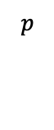
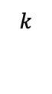
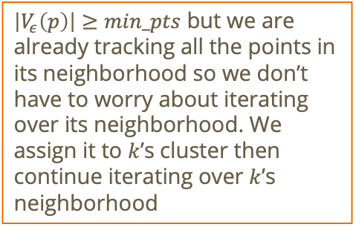
DBScan visualized
Min_pts = 3
$\left|V_{ε}\left(p\right)\right|≥min_pts$ but we are already tracking all the points in its neighborhood so we don’t have to worry about iterating over its neighborhood. We assign it to $k$’s cluster then continue iterating over $k$’s neighborhood
$$p$$
$$k$$

Slide 25
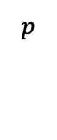
DBScan visualized
Min_pts = 3
$$k$$
Same thing as before!
$$p$$

Slide 26
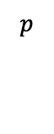
DBScan visualized
Min_pts = 3
$$k$$
Same thing as before!
$$p$$

Slide 27
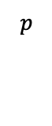
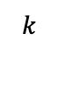
DBScan visualized
Min_pts = 3
$$k$$
Same thing as before!
$$p$$

Slide 28
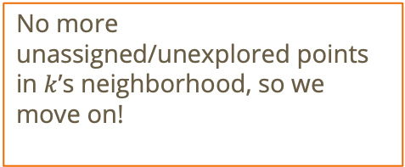
DBScan visualized
Min_pts = 3
No more unassigned/unexplored points in $k$’s neighborhood, so we move on!
$$k$$

Slide 29
DBScan visualized
Min_pts = 3

Slide 30
DBScan visualized
Min_pts = 3

Slide 31
DBScan visualized
Min_pts = 3

Slide 32
DBScan visualized
Min_pts = 3

Slide 33
DBScan visualized
Min_pts = 3

Slide 34
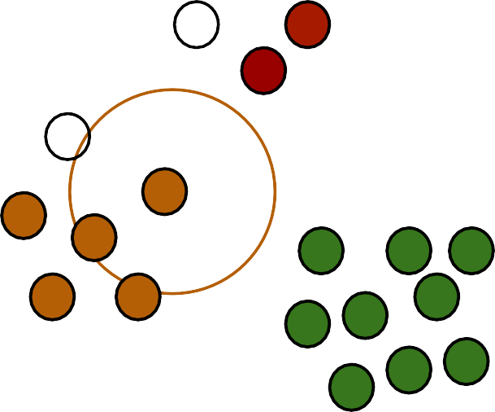
DBScan visualized
Min_pts = 3

Slide 35
DBScan visualized
Min_pts = 3
What about these two points?

Slide 36
DBScan visualized
Min_pts = 3
They are neither core points nor border points

Slide 37
DBScan visualized
Min_pts = 3
So they are noise points and remain unassigned ☹

Slide 38
Do not edit How to change the design
Keeping epsilon the same and increasing min_pts in DBScan WON’T decrease the number of noise points
The Slido app must be installed on every computer you’re presenting from

Slide 39
Do not edit How to change the design
Keeping epsilon the same and increasing min_pts in DBScan WON’T decrease the number of core points
The Slido app must be installed on every computer you’re presenting from

Slide 40
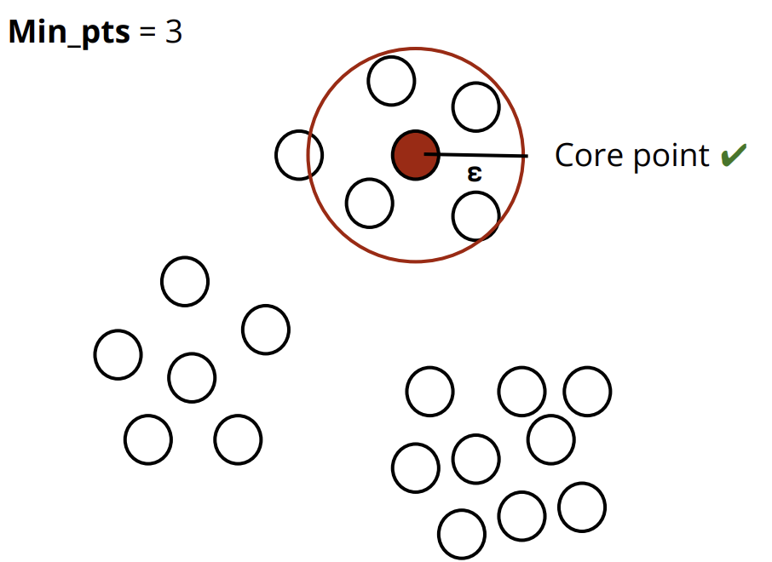

Slide 41
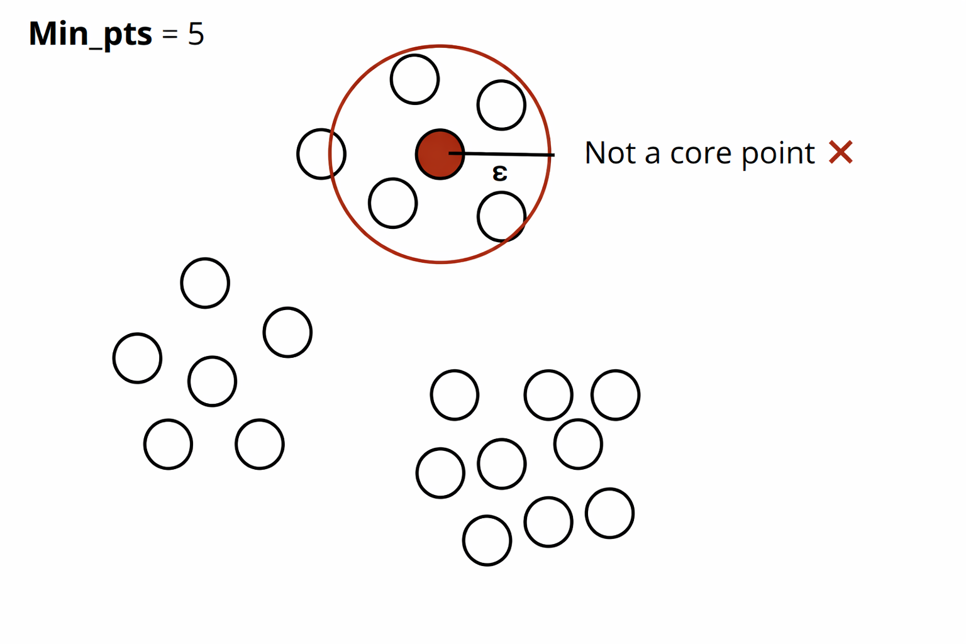

Slide 42
Do not edit How to change the design
Is the following a possible output from DBScan clustering?
The Slido app must be installed on every computer you’re presenting from

Slide 43
Do not edit How to change the design
Is DBScan well suited for the following dataset?
The Slido app must be installed on every computer you’re presenting from

Slide 44
Recall: Benefits of DBScan
Can identify clusters of different shapes and sizes
Resistant to noise points

Slide 45
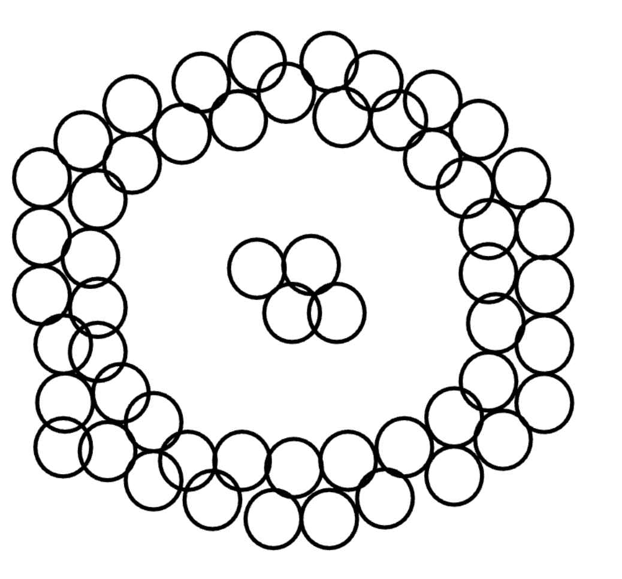

Could DBScan converge to the two “natural” clusters here?
min_pts = 2
$$ε$$

Slide 46
Do not edit How to change the design
DBScan, like K-means, requires you to specify the number of clusters
The Slido app must be installed on every computer you’re presenting from

Slide 47
Do not edit How to change the design
Using cosine distance to calculate epsilon neighborhoods would likely enable us to detect the two natural clusters here.
The Slido app must be installed on every computer you’re presenting from

Slide 48
Soft Clustering/Gaussian Mixture Modeling (GMM)

Slide 49
Recall: Soft Clustering
Points are not hard-assigned to clusters!

Slide 50
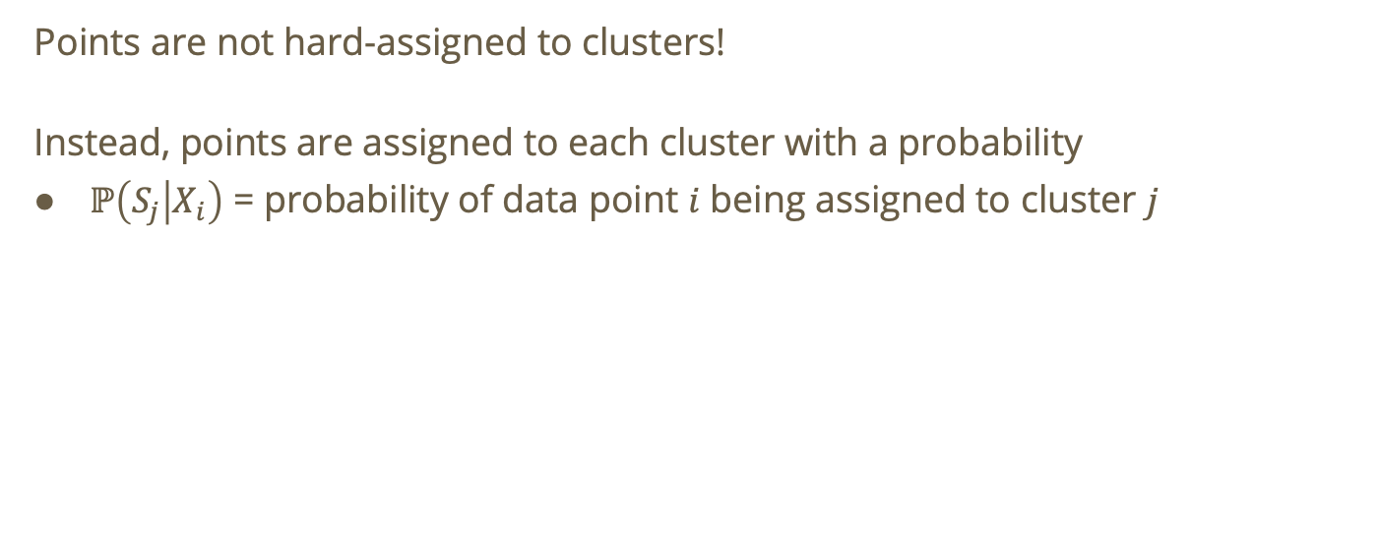
Recall: Soft Clustering
Points are not hard-assigned to clusters!
Instead, points are assigned to each cluster with a probability
$ℙ\left(S_{j} | X_{i}\right)$ = probability of data point $i$ being assigned to cluster $j$

Slide 51
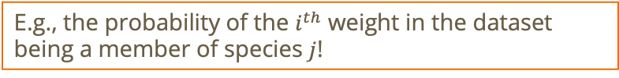
Recall: Soft Clustering
Points are not hard-assigned to clusters!
Instead, points are assigned to each cluster with a probability
$ℙ\left(S_{j} | X_{i}\right)$ = probability of data point $i$ being assigned to cluster $j$
E.g., the probability of the $i^{th}$ weight in the dataset being a member of species $j$!

Slide 52
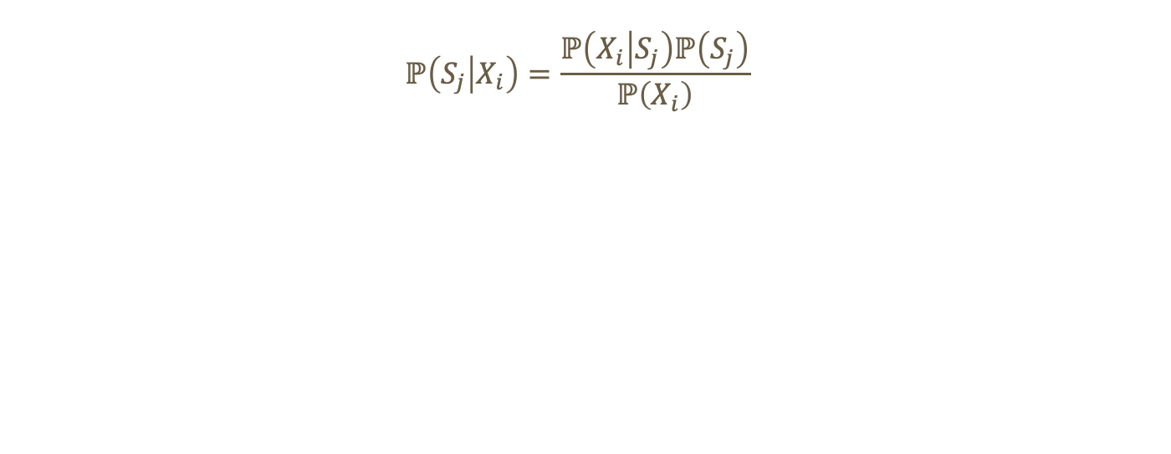
Recall: Computing $ℙ\left(S_{j} | X_{i}\right)$
$$ℙ\left(S_{j} | X_{i}\right)=\frac{ℙ\left(X_{i} | S_{j}\right)ℙ\left(S_{j}\right)}{ℙ\left(X_{i}\right)}$$

Slide 53
$$ℙ\left(S_{j} | X_{i}\right)=\frac{ℙ\left(X_{i} | S_{j}\right)ℙ\left(S_{j}\right)}{ℙ\left(X_{i}\right)}$$
Bayes Theorem!

Slide 54
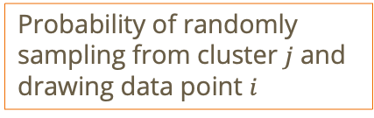
Probability of randomly sampling from cluster $j$ and drawing data point $i$
$$ℙ\left(S_{j} | X_{i}\right)=\frac{ℙ\left(X_{i} | S_{j}\right)ℙ\left(S_{j}\right)}{ℙ\left(X_{i}\right)}$$

Slide 55

Probability of randomly sampling from cluster $j$ and drawing data point $i$
$$ℙ\left(S_{j} | X_{i}\right)=\frac{ℙ\left(X_{i} | S_{j}\right)ℙ\left(S_{j}\right)}{ℙ\left(X_{i}\right)}$$
Prior probability of any data point being a member of cluster $j$

Slide 56

Probability of randomly sampling from cluster $j$ and drawing data point $i$
$$ℙ\left(S_{j} | X_{i}\right)=\frac{ℙ\left(X_{i} | S_{j}\right)ℙ\left(S_{j}\right)}{ℙ\left(X_{i}\right)}$$
Prior probability of any data point being a member of cluster $j$
Prior probability of drawing data point $i$

Slide 57

Probability of randomly sampling from cluster $j$ and drawing data point $i$
$$ℙ\left(S_{j} | X_{i}\right)=\frac{ℙ\left(X_{i} | S_{j}\right)ℙ\left(S_{j}\right)}{ℙ\left(X_{i}\right)}$$
Requirement:
$$\sum_{j=1}^{k}{ℙ\left(S_{j} | X_{i}\right)}=1$$
Prior probability of any data point being a member of cluster $j$
Prior probability of drawing data point $i$
Notes:
Requirement: the sum of the probabilities, that data point i belongs to each cluster j, must equal 1

Slide 58

Mixture Model
$$ℙ\left(S_{j} | X_{i}\right)=\frac{ℙ\left(X_{i} | S_{j}\right)ℙ\left(S_{j}\right)}{ℙ\left(X_{i}\right)}$$
We say $X$ comes from a mixture model if
$$ℙ\left(X_{i}\right)=\sum_{j∈Ω}{ℙ\left(S_{j}\right)ℙ\left(X_{i} | S_{j}\right)},Ω=\{j_{1},j_{2},…,j_{k}\}$$
Notes:
Recall, \omega is the set of all clusters/classes

Slide 59

$$ℙ\left(S_{j} | X_{i}\right)=\frac{ℙ\left(X_{i} | S_{j}\right)ℙ\left(S_{j}\right)}{ℙ\left(X_{i}\right)}$$
We say $X$ comes from a mixture model if
$$ℙ\left(X_{i}\right)=\sum_{j∈Ω}{ℙ\left(S_{j}\right)ℙ\left(X_{i} | S_{j}\right)}$$
Law of total probability!

Slide 60

Mixture Model
$$ℙ\left(S_{j} | X_{i}\right)=\frac{ℙ\left(X_{i} | S_{j}\right)ℙ\left(S_{j}\right)}{ℙ\left(X_{i}\right)}$$
We say $X$ comes from a mixture model if
$$ℙ\left(X_{i}\right)=\sum_{j∈Ω}{ℙ\left(S_{j}\right)ℙ\left(X_{i} | S_{j}\right)}$$
Mixture proportion belonging to cluster $j$

Slide 61

Gaussian Mixture Model
$$ℙ\left(S_{j} | X_{i}\right)=\frac{ℙ\left(X_{i} | S_{j}\right)ℙ\left(S_{j}\right)}{ℙ\left(X_{i}\right)}$$
We say $X$ comes from a mixture model if
$$ℙ\left(X_{i}\right)=\sum_{j∈Ω}{ℙ\left(S_{j}\right)ℙ\left(X_{i} | S_{j}\right)}$$
$X$ comes from a Gaussian mixture model if
$$ℙ\left(X | S_{j}\right)∼𝒩\left(μ_{j},σ_{j}^{2}\right)$$

Slide 62
$$ℙ\left(S_{j} | X_{i}\right)=\frac{ℙ\left(X_{i} | S_{j}\right)ℙ\left(S_{j}\right)}{ℙ\left(X_{i}\right)}$$
We say $X$ comes from a mixture model if
$$ℙ\left(X_{i}\right)=\sum_{j∈Ω}{ℙ\left(S_{j}\right)ℙ\left(X_{i} | S_{j}\right)}$$
$X$ comes from a Gaussian mixture model if
$$ℙ\left(X | S_{j}\right)∼𝒩\left(μ_{j},σ_{j}^{2}\right)$$
The data points in each cluster follow a normal distribution parameterized with w.r.t. that cluster

Slide 63
Recall: Maximum Likelihood Estimation (MLE)
Goal: find parameters that maximize the probability of having seen the data we got
Notes:
Recall the coin flip example!

Slide 64

GMM Clustering
Goal: find the GMM clustering that maximizes the probability of seeing the data we have
$$ℙ\left(X_{i}\right)=\sum_{j∈Ω}{ℙ\left(S_{j}\right)ℙ\left(X_{i} | S_{j}\right)}$$
“Data we saw”

Slide 65
GMM Clustering
Goal: find the GMM clustering that maximizes the probability of seeing the data we have
$$ℙ\left(X_{i}\right)=\sum_{j∈Ω}{ℙ\left(S_{j}\right)ℙ\left(X_{i} | S_{j}\right)}$$
Find parameters that maximize this probability!

Slide 66
GMM Clustering
Goal: find the GMM clustering that maximizes the probability of seeing the data we have
Enter… Maximum Likelihood Estimation!
$$ℙ\left(X_{i}\right)=\sum_{j∈Ω}{ℙ\left(S_{j}\right)ℙ\left(X_{i} | S_{j}\right)}$$
Find parameters that maximize this probability!

Slide 67

GMM Clustering
Goal: find the GMM clustering that maximizes the probability of seeing the data we have
Enter… Maximum Likelihood Estimation!
The probability of seeing the data we saw would be the product of observing each of the data points (assuming they were sampled independently)
$$ℙ\left(X_{i}\right)=\sum_{j∈Ω}{ℙ\left(S_{j}\right)ℙ\left(X_{i} | S_{j}\right)}$$

Slide 68

GMM Clustering
Goal: find the GMM clustering that maximizes the probability of seeing the data we have
Enter… Maximum Likelihood Estimation!
The probability of seeing the data we saw would be the product of observing each of the data points (assuming they were sampled independently)
i.e., $ℙ\left(X_{1}\right)∧ℙ\left(X_{2}\right)∧ℙ\left(X_{3}\right)∧⋯∧ℙ\left(X_{N}\right)=ℙ\left(X_{1}\right)×ℙ\left(X_{2}\right)×ℙ\left(X_{3}\right)×⋯×ℙ\left(X_{N}\right)$
$$ℙ\left(X_{i}\right)=\sum_{j∈Ω}{ℙ\left(S_{j}\right)ℙ\left(X_{i} | S_{j}\right)}$$

Slide 69
GMM Clustering
Goal: find the GMM clustering that maximizes the probability of seeing the data we have
Enter… Maximum Likelihood Estimation!
The probability of seeing the data we saw would be the product of observing each of the data points (assuming they were sampled independently)
i.e., $ℙ\left(X_{1}\right)∧ℙ\left(X_{2}\right)∧ℙ\left(X_{3}\right)∧⋯∧ℙ\left(X_{N}\right)=ℙ\left(X_{1}\right)×ℙ\left(X_{2}\right)×ℙ\left(X_{3}\right)×⋯×ℙ\left(X_{N}\right)$
$$ℙ\left(X_{i}\right)=\sum_{j∈Ω}{ℙ\left(S_{j}\right)ℙ\left(X_{i} | S_{j}\right)}$$
Probability of observing data point 1 and probability of observing data point 2 and…

Slide 70


Probability of observing each data point
$$\prod_{i=1}^{N}{ℙ\left(X_{i}\right)}$$
Equivalent to $ℙ\left(X_{1}\right)×ℙ\left(X_{2}\right)×ℙ\left(X_{3}\right)×⋯×ℙ\left(X_{N}\right)$

Slide 71

Probability of observing each data point
$$\prod_{i=1}^{N}{ℙ\left(X_{i}\right)}$$
$$=\prod_{i=1}^{N}{\sum_{j=1}^{k}{ℙ\left(S_{j}\right)ℙ\left(X_{i} | S_{j}\right)}}$$

Slide 72

Probability of observing each data point
$$\prod_{i=1}^{N}{ℙ\left(X_{i}\right)}$$
$$=\prod_{i=1}^{N}{\sum_{j=1}^{k}{ℙ\left(S_{j}\right)ℙ\left(X_{i} | S_{j}\right)}}$$
Goal: we want to find the parameters that maximize this probability!

Slide 73
Probability of observing each data point
$$\prod_{i=1}^{N}{ℙ\left(X_{i}\right)}$$
$$=\prod_{i=1}^{N}{\sum_{j=1}^{k}{ℙ\left(S_{j}\right)ℙ\left(X_{i} | S_{j}\right)}}$$

Slide 74
Recall: Maximum Likelihood Estimation (MLE)
Find the parameters that maximize the probability of seeing the data we saw.

Slide 75
Recall: Maximum Likelihood Estimation (MLE)
Find the parameters that maximize the probability of seeing the data we saw.
E.g., estimating the parameter for a Bernoulli(p) distribution that maximize the probability of flipping 2 heads and 3 heads on a coin where the probability of flipping heads = p

Slide 76

Recall: Maximum Likelihood Estimation (MLE)
Find the parameters that maximize the probability of seeing the data we saw.
In our case, we want to find the GMM clustering that maximizes
$$\prod_{i=1}^{N}{\sum_{j=1}^{k}{ℙ\left(S_{j}\right)ℙ\left(X_{i} | S_{j}\right)}}$$
Probability of seeing all the data points we saw!

Slide 77
Recall: Maximum Likelihood Estimation (MLE)
Find the parameters that maximize the probability of seeing the data we saw.
In our case, we want to find the GMM clustering that maximizes
$$\prod_{i=1}^{N}{\sum_{j=1}^{k}{ℙ\left(S_{j}\right)ℙ\left(X_{i} | S_{j}\right)}}$$
This is also called the likelihood!

Slide 78
Maximum Likelihood Estimation for GMM
How do we typically find the maximum of functions? Hmm…

Slide 79
Maximum Likelihood Estimation for GMM
How do we typically find the maximum of functions? Hmm…
Critical points!!! → Derivatives

Slide 80

Maximum Likelihood Estimation for GMM
How do we typically find the maximum of functions? Hmm…
Critical points!!! → Derivatives
$$\prod_{i=1}^{N}{\sum_{j=1}^{k}{ℙ\left(S_{j}\right)ℙ\left(X_{i} | S_{j}\right)}}$$
Taking the derivative of this looks a little hard... Let’s use a log transform to get rid of the product

Slide 81

Maximum Likelihood Estimation for GMM
$$\log\left(\prod_{i=1}^{N}{\sum_{j=1}^{k}{ℙ\left(S_{j}\right)ℙ\left(X_{i} | S_{j}\right)}}\right)$$
$$=\sum_{i=1}^{N}{\log\left(\sum_{j=1}^{k}{ℙ\left(S_{j}\right)ℙ\left(X_{i} | S_{j}\right)}\right)}$$

Slide 82

Maximum Likelihood Estimation for GMM
$$\log\left(\prod_{i=1}^{N}{\sum_{j=1}^{k}{ℙ\left(S_{j}\right)ℙ\left(X_{i} | S_{j}\right)}}\right)$$
$$=\sum_{i=1}^{N}{\log\left(\sum_{j=1}^{k}{ℙ\left(S_{j}\right)ℙ\left(X_{i} | S_{j}\right)}\right)}$$
Don’t forget!!! → $ℙ\left(X_{i} | S_{j}\right)∼𝒩\left(μ_{j},σ_{j}^{2}\right)$

Slide 83

Maximum Likelihood Estimation for GMM
$$\log\left(\prod_{i=1}^{N}{\sum_{j=1}^{k}{ℙ\left(S_{j}\right)ℙ\left(X_{i} | S_{j}\right)}}\right)$$
$$=\sum_{i=1}^{N}{\log\left(\sum_{j=1}^{k}{ℙ\left(S_{j}\right)ℙ\left(X_{i} | S_{j}\right)}\right)}$$
Don’t forget!!! → $ℙ\left(X_{i} | S_{j}\right)∼𝒩\left(μ_{j},σ_{j}^{2}\right)$
Now, taking the derivative and solving for the critical points, we can find expressions for the maximum $μ,σ,ℙ\left(S_{j}\right)$

Slide 84

Maximum Likelihood Estimation for GMM
$$ℙ\left(S_{j}\right)=\frac{1}{N}\sum_{i=1}^{N}{ℙ\left(S_{j} | X_{i}\right)}$$
$$μ_{j}=\frac{\sum_{i=1}^{N}{ℙ\left(S_{j} | X_{i}\right)X_{i}}}{\sum_{i=1}^{N}{ℙ\left(S_{j} | X_{i}\right)}}$$
$$Σ_{j}=\frac{\sum_{i=1}^{N}{ℙ\left(S_{j} | X_{i}\right)\left(X_{i}−μ_{j}\right){\left(X_{i}−μ_{j}\right)}^{T}}}{\sum_{i=1}^{N}{ℙ\left(S_{j} | X_{i}\right)}}$$

Slide 85
Expectation Maximization (EM) Algorithm
We use this algorithm to iteratively estimate the parameters for our GMM

Slide 86

Start with a random $μ_{j},Σ_{j},ℙ\left(S_{j}\right)$

Slide 87

Start with a random $μ_{j},Σ_{j},ℙ\left(S_{j}\right)$
Compute $ℙ\left(S_{j} | X_{i}\right), ∀X_{i}$ using $μ_{j},Σ_{j},ℙ\left(S_{j}\right)$

Slide 88

Start with a random $μ_{j},Σ_{j},ℙ\left(S_{j}\right)$
Compute $ℙ\left(S_{j} | X_{i}\right), ∀X_{i}$ using $μ_{j},Σ_{j},ℙ\left(S_{j}\right)$
Update $μ_{j},Σ_{j},ℙ\left(S_{j}\right)$ from $ℙ\left(S_{j} | X_{i}\right)$

Slide 89

Start with a random $μ_{j},Σ_{j},ℙ\left(S_{j}\right)$
Compute $ℙ\left(S_{j} | X_{i}\right), ∀X_{i}$ using $μ_{j},Σ_{j},ℙ\left(S_{j}\right)$
Update $μ_{j},Σ_{j},ℙ\left(S_{j}\right)$ from $ℙ\left(S_{j} | X_{i}\right)$
Repeat 2 and 3 until convergence

Slide 90

Question: how do we update the parameters?
Let $γ_{ij}=ℙ\left(S_{j} | X_{i}\right)$

Slide 91

Question: how do we update the parameters?
Let $γ_{ij}=ℙ\left(S_{j} | X_{i}\right)$
Update the parameters according to the following
$ℙ\left(S_{j}\right)=\frac{1}{N}\sum_{i=1}^{N}{γ_{ij}}$

Slide 92

Question: how do we update the parameters?
Let $γ_{ij}=ℙ\left(S_{j} | X_{i}\right)$
Update the parameters according to the following
$ℙ\left(S_{j}\right)=\frac{1}{N}\sum_{i=1}^{N}{γ_{ij}}$
$μ_{j}=\frac{\sum_{i=1}^{N}{γ_{ij}X_{i}}}{\sum_{i=1}^{N}{γ_{ij}}}$
$Σ_{j}=\frac{\sum_{i=1}^{N}{γ_{ij}\left(X_{i}−μ_{j}\right){\left(X_{i}−μ_{j}\right)}^{T}}}{\sum_{i=1}^{N}{γ_{ij}}}$

Slide 93
Question: how do we update the parameters?
Let $γ_{ij}=ℙ\left(S_{j} | X_{i}\right)$
Update the parameters according to the following
$ℙ\left(S_{j}\right)=\frac{1}{N}\sum_{i=1}^{N}{γ_{ij}}$
$μ_{j}=\frac{\sum_{i=1}^{N}{γ_{ij}X_{i}}}{\sum_{i=1}^{N}{γ_{ij}}}$
$Σ_{j}=\frac{\sum_{i=1}^{N}{γ_{ij}\left(X_{i}−μ_{j}\right){\left(X_{i}−μ_{j}\right)}^{T}}}{\sum_{i=1}^{N}{γ_{ij}}}$
These are the critical points we solved for earlier!!!

Slide 94

Question: how do we measure convergence?
Let $ℒ =$log likelihood of the current GMM, i.e. how well does the current GMM explain the observed data

Slide 95

Question: how do we measure convergence?
Let $ℒ =$log likelihood of the current GMM, i.e. how well does the current GMM explain the observed data
$$ℒ=\sum_{i=1}^{N}{\log\left(\sum_{j=1}^{k}{ℙ\left(S_{j}\right)ℙ\left(X_{i} | S_{j}\right)}\right)}$$

Slide 96

Question: how do we measure convergence?
Let $ℒ =$log likelihood of the current GMM, i.e. how well does the current GMM explain the observed data
We converge if
$$\left|ℒ^{\left(t\right)}−ℒ^{\left(t−1\right)}\right|<ε$$
For some $ε> 0$

Slide 97

Question: how do we measure convergence?
Let $ℒ =$log likelihood of the current GMM, i.e. how well does the current GMM explain the observed data
We converge if
$$\left|ℒ^{\left(t\right)}−ℒ^{\left(t−1\right)}\right|<ε$$
For some $ε> 0$
EM guarantees
$$ℒ^{\left(t\right)}≥ℒ^{\left(t−1\right)}$$

Slide 98
Do not edit How to change the design
How many parameters does GMM need to estimate for k clusters and 1D data?
The Slido app must be installed on every computer you’re presenting from

Slide 99
Do not edit How to change the design
Since outliers most likely don’t belong to any cluster, the probabilities of belonging to each cluster, assigned by a GMM, will all be small
The Slido app must be installed on every computer you’re presenting from
Notes:
Key idea: the probability P(S_j | X_i) for all S_j must sum to 1! So not all of the probabilities can be small

Slide 100
Do not edit How to change the design
What type of distribution does each cluster follow in a GMM?
The Slido app must be installed on every computer you’re presenting from

Slide 101
Do not edit How to change the design
One way to initialize GMM clustering is to use K-means since it also performs well when clusters are Gaussian
The Slido app must be installed on every computer you’re presenting from

Slide 102
Do not edit How to change the design
In GMM, what is the likelihood of the data (with N data points) when k=N
The Slido app must be installed on every computer you’re presenting from

Slide 103

Solution
$$\prod_{i=1}^{N}{\sum_{j=1}^{k}{ℙ\left(S_{j}\right)ℙ\left(X_{i} | S_{j}\right)}}$$
$$=\prod_{i=1}^{N}{\sum_{j=1}^{N}{ℙ\left(S_{j}\right)ℙ\left(X_{i} | S_{j}\right)}}$$
$$=\prod_{i=1}^{N}{\sum_{j=1}^{N}{ℙ\left(S_{j}\right)𝒩\left(X_{i},σ_{j}\right)}}$$

Slide 104

Solution (cont.)
$$\prod_{i=1}^{N}{\sum_{j=1}^{N}{ℙ\left(S_{j}\right)𝒩\left(X_{i},σ_{j}\right)}}$$
Because $k=N$, we can assume variance approaches 0
$$\prod_{i=1}^{N}{\sum_{j=1}^{N}{\lim_{σ_{j}→0}{ℙ\left(S_{j}\right)}𝒩\left(X_{i},σ_{j}^{2}\right)}}$$
$$=\prod_{i=1}^{N}{\sum_{j=1}^{N}{ℙ\left(S_{j}\right)\lim_{σ_{j}→0}{\frac{1}{\sqrt{2π}σ_{j}}}}}$$
Notes:
To motivate the variance being 0, think about kmeans with k=N and how the clusters look

Slide 105

Solution (cont.)
$$=\prod_{i=1}^{N}{\sum_{j=1}^{N}{ℙ\left(S_{j}\right)\lim_{σ_{j}→0}{\frac{1}{\sqrt{2π}σ_{j}}}}}$$
Examining the limit…
$$\lim_{σ_{j}→0}{\frac{1}{\sqrt{2π}σ_{j}}}=∞$$

Slide 106
Solution – qualitative approach!
If k=N, then the normal density will have a variance of zero → density is unbounded at the mean → “infinite” density height at the mean

Slide 107
K-Means(++)

Slide 108
Do not edit How to change the design
Is the following a possible output from K-means++ clustering?
The Slido app must be installed on every computer you’re presenting from

Slide 109

Solution
Considerations:
Are there points in a cluster that are closer to the mean of another cluster than its own?
Are clusters well separated?
Are clusters roughly globular?
Are clusters roughly even sized?

Slide 110
Solution
Considerations:
Are there points in a cluster that are closer to the mean of another cluster than its own?
Are clusters well separated?
Are clusters roughly globular?
Are clusters roughly even sized?
*These aren’t rules to determine whether a clustering is a possible output of K-means, rather just considerations to guide your intuition

Slide 111
Do not edit How to change the design
Is the following a possible output of K-means clustering?
The Slido app must be installed on every computer you’re presenting from

Slide 112
Do not edit How to change the design
The difference between K-means and K-means++ is that K-means++ is faster, hence the ++
The Slido app must be installed on every computer you’re presenting from

Slide 113
Do not edit How to change the design
Consider the 1-dimensional dataset [4,5,x]. With k=2 and x>5, what is the smallest value of x BEYOND which x will always be in its own cluster?
The Slido app must be installed on every computer you’re presenting from

Slide 114
Solution
Let’s find the “most drastic case” which we want to be able to account for.

Slide 115

Solution
Consider the following clustering
$$C_{1}=\{4\},C_{2}=\{5,x\}$$

Slide 116

Solution
Consider the following clustering
$$C_{1}=\{4\},C_{2}=\{5,x\}$$
What is the smallest value of $x$ such that 5 will always switch clusters?

Slide 117

Solution
Consider the following clustering
$$C_{1}=\{4\},C_{2}=\{5,x\}$$
What is the smallest value of $x$ such that 5 will always switch clusters?
i.e., what is the smallest value of $x$ such that
$$d\left(5,μ_{1}\right)<d\left(5,μ_{2}\right)$$

Slide 118

Consider the following clustering
$$C_{1}=\{4\},C_{2}=\{5,x\}$$
$$d\left(5,μ_{1}\right)<d\left(5,μ_{2}\right)$$
$$\left|5−4\right|<\left|5−\frac{5+x}{2}\right|$$

Slide 119

Consider the following clustering
$$C_{1}=\{4\},C_{2}=\{5,x\}$$
$$d\left(5,μ_{1}\right)<d\left(5,μ_{2}\right)$$
$$\left|5−4\right|<\left|5−\frac{5+x}{2}\right|$$
$$1<\left|\frac{5−x}{2}\right|$$

Slide 120

Consider the following clustering
$$C_{1}=\{4\},C_{2}=\{5,x\}$$
$$d\left(5,μ_{1}\right)<d\left(5,μ_{2}\right)$$
$$\left|5−4\right|<\left|5−\frac{5+x}{2}\right|$$
$$1<\left|\frac{5−x}{2}\right|$$
$$1<\frac{x−5}{2}$$

Slide 121

Consider the following clustering
$$C_{1}=\{4\},C_{2}=\{5,x\}$$
$$1<\frac{x−5}{2}$$
$$2<x−5$$

Slide 122

Consider the following clustering
$$C_{1}=\{4\},C_{2}=\{5,x\}$$
$$1<\frac{x−5}{2}$$
$$2<x−5$$
$$7<x$$

Slide 123
Do not edit How to change the design
Is the following a possible output from k-means++ clustering?
The Slido app must be installed on every computer you’re presenting from

Slide 124
Considerations
If you think that k-means cannot converge to the clustering, you should ask yourself, “why not?” and “what could it actually converge to?”

Slide 125
Do not edit How to change the design
Is the following a possible output of k-means clustering?
The Slido app must be installed on every computer you’re presenting from

Slide 126
Hierarchical Clustering

Slide 127

Recall: agglomerative vs. divisive clustering
Agglomerative: Start with each data point in its own cluster and merge the two closest data points/clusters at each step until every point is in 1 cluster
Divisive: Start with every data point in one cluster $(k=1)$and partition the dataset into $k+1$ clusters iteratively until $k =N$

Slide 128
Do not edit How to change the design
One way to divide clusters in Hierarchical Clustering's Divisive Algorithm (as opposed to agglomerative) is to use a partitional clustering method like K-means.
The Slido app must be installed on every computer you’re presenting from

Slide 129

Recall: link functions
Single-link distance: $D_{SL}\left(C_{1}, C_{2}\right)$ = $\min{\{d\left(p_{1},p_{2}\right)|p_{1}∈C_{1},p_{2}∈C_{2}}\}$
Complete-link distance: $D_{CL}\left(C_{1},C_{2}\right)=\max{\{d\left(p_{1},p_{2}\right)|p_{1}∈C_{1},p_{2}∈C_{2}\}}$
Average-link distance: $D_{AL}\left(C_{1},C_{2}\right)=\frac{1}{\left|C_{1}\right|\left|C_{2}\right|}\sum_{p_{1}∈C_{1},p_{2}∈C_{2}}{d\left(p_{1},p_{2}\right)}$
Centroid distance: $D_{c}\left(C_{1},C_{2}\right)=d\left(μ_{1},μ_{2}\right)$
Ward’s distance:
$D_{WD}\left(C_{1},C_{2}\right)=\sum_{p∈C_{12}}{d\left(p,μ_{12}\right)}−\sum_{p_{1}∈C_{1}}{d\left(p_{1},μ_{1}\right)}−\sum_{p_{2}∈C_{2}}{d\left(p_{2},μ_{2}\right)}$

Slide 130




Example
What would merge next under single-link distance?
$$B\left(0,3\right)$$
$$A\left(1,2\right)$$
$$C\left(−1,0\right)$$
$$D\left(3,0\right)$$

Slide 131



Example
What would merge next under single-link distance?
$$B\left(0,3\right)$$
$$A\left(1,2\right)$$
$$\sqrt{10}$$
$$\sqrt{8}$$
$$C\left(−1,0\right)$$
$$D\left(3,0\right)$$

Slide 132

Example
What would merge next under single-link distance?
$$B\left(0,3\right)$$
$$D_{SL}\left(C,AB\right)=\min{\{\sqrt{10}},\sqrt{8}\}=\sqrt{8}$$
$$A\left(1,2\right)$$
$$\sqrt{10}$$
$$\sqrt{8}$$
$$C\left(−1,0\right)$$
$$D\left(3,0\right)$$

Slide 133


Example
What would merge next under single-link distance?
$$B\left(0,3\right)$$
$$D_{SL}\left(C,AB\right)=\min{\{\sqrt{10}},\sqrt{8}\}=\sqrt{8}$$
$$\sqrt{18}$$
$$A\left(1,2\right)$$
$$\sqrt{8}$$
$$C\left(−1,0\right)$$
$$D\left(3,0\right)$$

Slide 134

Example
What would merge next under single-link distance?
$$B\left(0,3\right)$$
$$D_{SL}\left(C,AB\right)=\min{\{\sqrt{10}},\sqrt{8}\}=\sqrt{8}$$
$$D_{SL}\left(D,AB\right)=\min{\{\sqrt{8}},\sqrt{18}\}=\sqrt{8}$$
$$\sqrt{18}$$
$$A\left(1,2\right)$$
$$\sqrt{8}$$
$$C\left(−1,0\right)$$
$$D\left(3,0\right)$$

Slide 135

Example
What would merge next under single-link distance?
$$B\left(0,3\right)$$
$$D_{SL}\left(C,AB\right)=\min{\{\sqrt{10}},\sqrt{8}\}=\sqrt{8}$$
$$D_{SL}\left(D,AB\right)=\min{\{\sqrt{8}},\sqrt{18}\}=\sqrt{8}$$
next_merge = $\min{\{}D_{SL}\left(C,AB\right),D_{SL}\left(D,AB\right)\}=\sqrt{8} →D or C!$
$$A\left(1,2\right)$$
$$C\left(−1,0\right)$$
$$D\left(3,0\right)$$

Slide 136
Example
What would merge next under complete-link distance?
$$B\left(0,3\right)$$
$$A\left(1,2\right)$$
$$C\left(−1,0\right)$$
$$D\left(3,0\right)$$

Slide 137

Example
What would merge next under complete-link distance?
$$B\left(0,3\right)$$
$$D_{CL}\left(C,AB\right)=\max{\{\sqrt{10}},\sqrt{8}\}=\sqrt{10}$$
$$A\left(1,2\right)$$
$$\sqrt{10}$$
$$\sqrt{8}$$
$$C\left(−1,0\right)$$
$$D\left(3,0\right)$$

Slide 138

Example
What would merge next under complete-link distance?
$$B\left(0,3\right)$$
$$D_{CL}\left(C,AB\right)=\max{\{\sqrt{10}},\sqrt{8}\}=\sqrt{10}$$
$$D_{CL}\left(D,AB\right)=\max{\{\sqrt{8}},\sqrt{18}\}=\sqrt{18}$$
$$\sqrt{18}$$
$$A\left(1,2\right)$$
$$\sqrt{8}$$
$$C\left(−1,0\right)$$
$$D\left(3,0\right)$$

Slide 139

Example
What would merge next under complete-link distance?
$$B\left(0,3\right)$$
$$D_{CL}\left(C,AB\right)=\max{\{\sqrt{10}},\sqrt{8}\}=\sqrt{10}$$
$$D_{CL}\left(D,AB\right)=\max{\{\sqrt{8}},\sqrt{18}\}=\sqrt{18}$$
next_merge = $\min{\{}D_{CL}\left(C,AB\right),D_{CL}\left(D,AB\right)\}=\sqrt{10}→C$
$$A\left(1,2\right)$$
$$C\left(−1,0\right)$$
$$D\left(3,0\right)$$

Slide 140
Example
What would merge next under complete-link distance?
$$B\left(0,3\right)$$
$$D_{CL}\left(C,AB\right)=\max{\{\sqrt{10}},\sqrt{8}\}=\sqrt{10}$$
$$D_{CL}\left(D,AB\right)=\max{\{\sqrt{8}},\sqrt{18}\}=\sqrt{18}$$
next_merge = $\min{\{}D_{CL}\left(C,AB\right),D_{CL}\left(D,AB\right)\}=\sqrt{10}→C$
$$A\left(1,2\right)$$
$$C\left(−1,0\right)$$
$$D\left(3,0\right)$$
This line is the same for all link functions!!
Notes:
THESE 2 EXAMPLES ARE REUSED FROM LAB4

Slide 141
Do not edit How to change the design
Using Euclidean and complete-link distance, what is the merging order for {A=(0,0), B=(1,1), C=(3,0), D=(0,-2)}?
The Slido app must be installed on every computer you’re presenting from

Slide 142


Solution
$$A=\left(0,0\right),B=\left(1,1\right),C=\left(3,0\right),D=\left(0,−2\right)$$
 | A | B | C | D
A | $$0$$ | $$\sqrt{2}$$ | $$3$$ | $$2$$
B | $$\sqrt{2}$$ | $$0$$ | $$\sqrt{5}$$ | $$\sqrt{10}$$
C | $$3$$ | $$\sqrt{5}$$ | $$0$$ | $$\sqrt{13}$$
D | 2 | $$\sqrt{10}$$ | $$\sqrt{13}$$ | $$0$$

Slide 143

Solution
$$A=\left(0,0\right),B=\left(1,1\right),C=\left(3,0\right),D=\left(0,−2\right)$$
 | AB | C | D
AB | $$0$$ | $$3$$ | $$\sqrt{10}$$
C | $$3$$ | $$0$$ | $$\sqrt{13}$$
D | $$\sqrt{10}$$ | $$\sqrt{13}$$ | $$0$$

Slide 144

Solution
$$A=\left(0,0\right),B=\left(1,1\right),C=\left(3,0\right),D=\left(0,−2\right)$$
 | ABC | D
ABC | $$0$$ | $$\sqrt{13}$$
D | $$\sqrt{13}$$ | $$0$$

Slide 145
Do not edit How to change the design
How many clusters would be created by cutting the dendrogram below as shown?
The Slido app must be installed on every computer you’re presenting from

Slide 146
Do not edit How to change the design
Which clusters get merged next if using Euclidean and complete-link distances?
The Slido app must be installed on every computer you’re presenting from

Slide 147
Distance and Similarity Functions

Slide 148

Recall: Minkowski Distance
Given $x,y∈ℝ^{d}$ and $p> 1$
$$L_{p}\left(x,y\right)={\left(\sum_{i=1}^{d}{{\left|x_{i}–y_{i}\right|}^{p}}\right)}^{\frac{1}{p}}$$

Slide 149

Recall: Minkowski Distance
Given $x,y∈ℝ^{d}$ and $p> 1$
$$L_{p}\left(x,y\right)={\left(\sum_{i=1}^{d}{{\left|x_{i}–y_{i}\right|}^{p}}\right)}^{\frac{1}{p}}$$
$p =1$ → Manhattan distance
$p=2$ → Euclidean distance

Slide 150
Do not edit How to change the design
The Manhattan distance is always less than or equal to the Euclidean distance between two points in a 2D space.
The Slido app must be installed on every computer you’re presenting from
Notes:
Example: A = (0,0), B = (1,1)

Slide 151
Do not edit How to change the design
In n-dimensional space the Manhattan distance equals the Euclidean distance for
The Slido app must be installed on every computer you’re presenting from
Notes:
Example: A(1,1) B(1,2) or A(2,1) B(1,1). Distance equals direct displacement!

Slide 152

Recall: Cosine Similarity
Similarity function takes two objects and returns a large value if the objects are similar
$s\left(x,y\right) = cos\left(θ\right)$ where $θ$ is the angle between x and y
If we have two proportional vectors: $s\left(x,y\right)=cos\left(0\right)=1$
If we have two orthogonal vectors: $s\left(x,y\right)=cos\left(\frac{π}{2}\right)=0$
If we have two opposite vectors: $s(x,y) = cos(π) = −1$
Cosine Distance = $1−s\left(x,y\right)$

Slide 153

Recall: Cosine Similarity
Similarity function takes two objects and returns a large value if the objects are similar
$s\left(x,y\right) = cos\left(θ\right)$ where $θ$ is the angle between x and y
If we have two proportional vectors: $s\left(x,y\right)=cos\left(0\right)=1$
If we have two orthogonal vectors: $s\left(x,y\right)=cos\left(\frac{π}{2}\right)=0$
If we have two opposite vectors: $s(x,y) = cos(π) = −1$
Cosine Distance = $1−s\left(x,y\right)$
Cosine similarity and distance depend on the angle between two vectors

Slide 154
Do not edit How to change the design
Consider arbitrary points A and B in R^n s.t. A != B. For which distance function d, is d(A,B) invariant to scaling? i.e., c * d(A,B) = d(A,B) for any constant c
The Slido app must be installed on every computer you’re presenting from
Notes:
Example: A(1,2) B (4,6)

Slide 155


Recall: Jaccard Similarity
$JSim\left(x,y\right)=\frac{\left|x∩y\right|}{\left|x∪y\right|}$
Jaccard similarity tells us how similar the data points are. Jaccard distance will tell us how dissimilar they are:
$JDist\left(x,y\right)=1–JSim\left(x,y\right)$
 | The Matrix | Arrival | $$…$$ | Iron Man
User 1 | 1 | 0 | $$…$$ | 1
User 2 | 0 | 1 | $$…$$ | 1

Slide 156
Do not edit How to change the design
What is the Jaccard distance between two completely different documents (i.e. no words in common at all)?
The Slido app must be installed on every computer you’re presenting from

Slide 157

Example
 | $$w_{1}$$ | $$w_{2}$$ | $$w_{3}$$ | $$w_{4}$$
Document 1 | 1 | 0 | 0 | 0
Document 2 | 0 | 1 | 1 | 1

Slide 158

Example
$$\left\|D_{1}∪D_{2}\right\| = \left(1 ∨ 0\right) + \left(0 ∨ 1\right) + \left(0 ∨1\right) + \left(0∨1\right) = 4$$
 | $$w_{1}$$ | $$w_{2}$$ | $$w_{3}$$ | $$w_{4}$$
Document 1 | 1 | 0 | 0 | 0
Document 2 | 0 | 1 | 1 | 1

Slide 159

Example
$$\left\|D_{1}∩D_{2}\right\|=\left(1∧0\right)+\left(0∧1\right)+\left(0∧1\right)+\left(0∧1\right)=0$$
 | $$w_{1}$$ | $$w_{2}$$ | $$w_{3}$$ | $$w_{4}$$
Document 1 | 1 | 0 | 0 | 0
Document 2 | 0 | 1 | 1 | 1

Slide 160


Example
$$J_{\text{sim}}\left(D_{1},D_{2}\right)=\frac{\left\|D_{1}∩D_{2}\right\|}{\left\|D_{1}∪D_{2}\right\|}=\frac{0}{4}$$
 | $$w_{1}$$ | $$w_{2}$$ | $$w_{3}$$ | $$w_{4}$$
Document 1 | 1 | 0 | 0 | 0
Document 2 | 0 | 1 | 1 | 1

Slide 161


Example
$$J_{\text{sim}}\left(D_{1},D_{2}\right)=\frac{\left\|D_{1}∩D_{2}\right\|}{\left\|D_{1}∪D_{2}\right\|}=\frac{0}{4} = 0$$
$$J_{\text{dist}}\left(D_{1},D_{2}\right)=1–J_{\text{sim}}\left(D_{1},D_{2}\right)$$
 | $$w_{1}$$ | $$w_{2}$$ | $$w_{3}$$ | $$w_{4}$$
Document 1 | 1 | 0 | 0 | 0
Document 2 | 0 | 1 | 1 | 1

Slide 162

Example
$$J_{\text{sim}}\left(D_{1},D_{2}\right)=\frac{\left\|D_{1}∩D_{2}\right\|}{\left\|D_{1}∪D_{2}\right\|}=\frac{0}{4} = 0$$
$$J_{\text{dist}}\left(D_{1},D_{2}\right)=1–J_{\text{sim}}\left(D_{1},D_{2}\right)$$
$$=1$$
 | $$w_{1}$$ | $$w_{2}$$ | $$w_{3}$$ | $$w_{4}$$
Document 1 | 1 | 0 | 0 | 0
Document 2 | 0 | 1 | 1 | 1

